Slide 1
DECISION PACK
Should you start an NDIS
provider business in Victoria?
The short answer: yes, there is a business here — but it is not the one your earlier files described, the numbers are roughly double, and the model that works is probably not core supports.
Prepared for Zaid Al Dabbag · 20 August 2026 · v1.0.0 · AI Project Governance Standard v3.7, class STANDARD
Every external figure verified on 20 August 2026. Decision support, not legal or financial advice.
Notes:
This pack summarises the full study at 05_Outputs/NDIS_Business_Enabling_Study_v1.0.docx. Every figure here traces to a SRC-### row in the source register.

Slide 2
WHERE IT LANDS
The five numbers that decide this
$21.30
$6.70
-$2.07
$15,875
Gross margin per billable hour of core support, before any overhead
What is left if you pay someone else to do the paperwork
What is left if that paperwork runs at 0.40 hours per billable hour
Cash at risk over six months with no revenue and NO drawings
$51,875
$7,319
40 hrs
127 hrs
The same six months if you draw $6,000 a month
Working capital behind the wage cycle — a line your earlier plan had no row for
Break-even per month if you do the administration yourself
Break-even per month if the administration is paid
Read tiles 1, 2 and 3 together. The price is not the problem. The administration load is — and there is a plausible, unfalsified version of this business where every hour you sell loses money.
02
Sources: SRC-002 price limit · SRC-009 wage · SRC-011 to SRC-013 on-costs · ASM-008 administration ratio (Low confidence)
Notes:
Tile 3 is the finding. No source publishes an administration-hours benchmark, so 0.40 cannot be ruled out.

Slide 3
YOUR EARLIER FILES
One of eight figures survived contact with a source
What the earlier files said | What the sourced position is
Budget of $15,000 to $30,000 | $15,875 with zero drawings, or $51,875 drawing $6,000/mo — plus working capital on top
Audit $900 to $1,800 | No auditor publishes a fee at all. Consultancy estimate: $3,500 to $6,000 verification
Registration takes 3 to 9 months | Verification 4 to 6 months. Certification 9 to 12 months
Set up a PRODA account | PRODA closes for Commission portals 30 Sep 2026. It is myID Strong plus RAM now
Nothing on mandatory registration | In force for SIL since 1 Jul 2026. Reaches personal care from Jul 2027
Nothing on working capital | $7,319 at a 14-day lag; $15,683 at 30 days
Nothing on the administration burden | It is the entire difference between a viable and an unviable business
ASIC Pty Ltd $636 | Still $636 — the only figure that held
03
DEF-001, raised under GOV-F8.8. The originals are archived, not deleted — 04_Inputs/legacy_unsourced and 06_Archive/_versions.

Slide 4
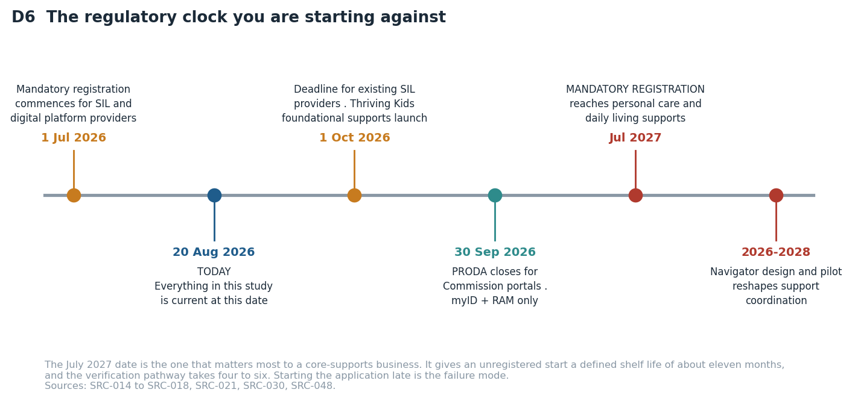
THE REGULATORY POSITION
You are starting against a clock
04
Verified against primary government sources by an independent verifier. Sources: SRC-014 to SRC-018, SRC-030, SRC-048.
Notes:
The July 2027 date is the one that matters. Verification registration takes 4-6 months, so the application starts in month one.

Slide 5
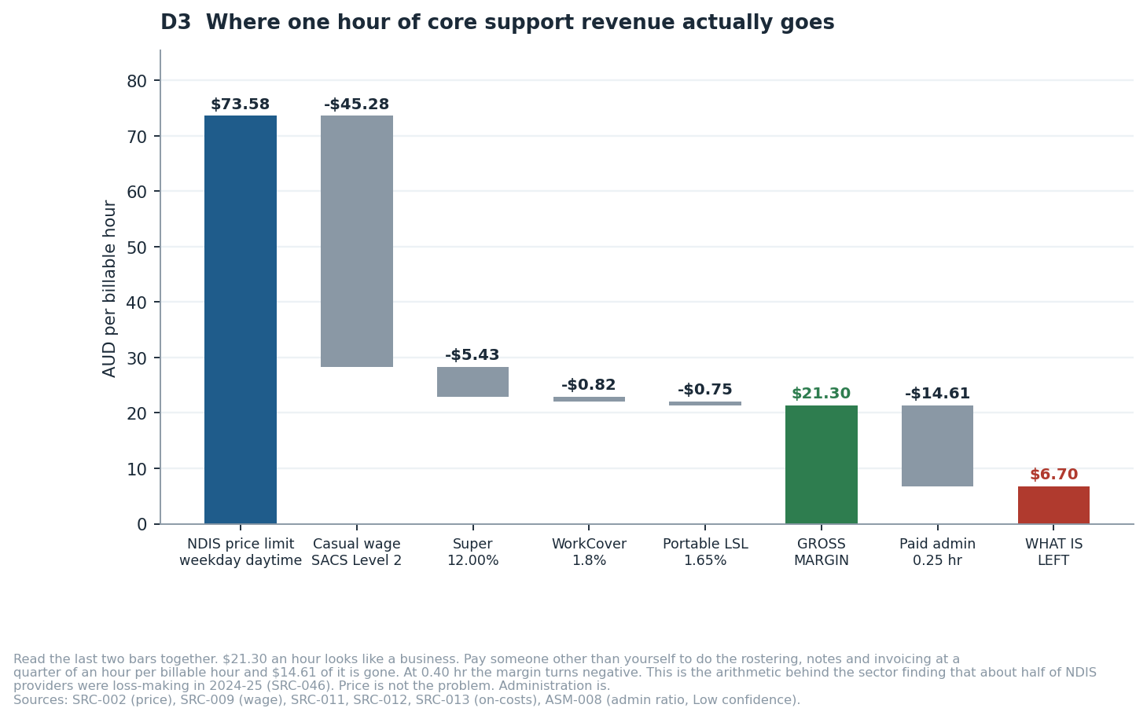
UNIT ECONOMICS
Where one hour of revenue actually goes
05
Independently re-derived by verifier V2, which found the first pass had omitted WorkCover and portable long service leave (DEF-002).

Slide 6
THE CASH CURVE
Twelve months of cash, before you pay yourself anything
Only one line works.
And only if you win a client by month four AND absorb every hour of administration yourself for nothing.
Delay the first client to month seven: never cash-positive in year one ($-4,341).
Pay for the administration: never cash-positive either ($-7,632).
None of these three pays you a wage.
06
REQ-SYS-07. All scenarios assume zero owner drawings. Change one driver in the financial model and every line moves.

Slide 7
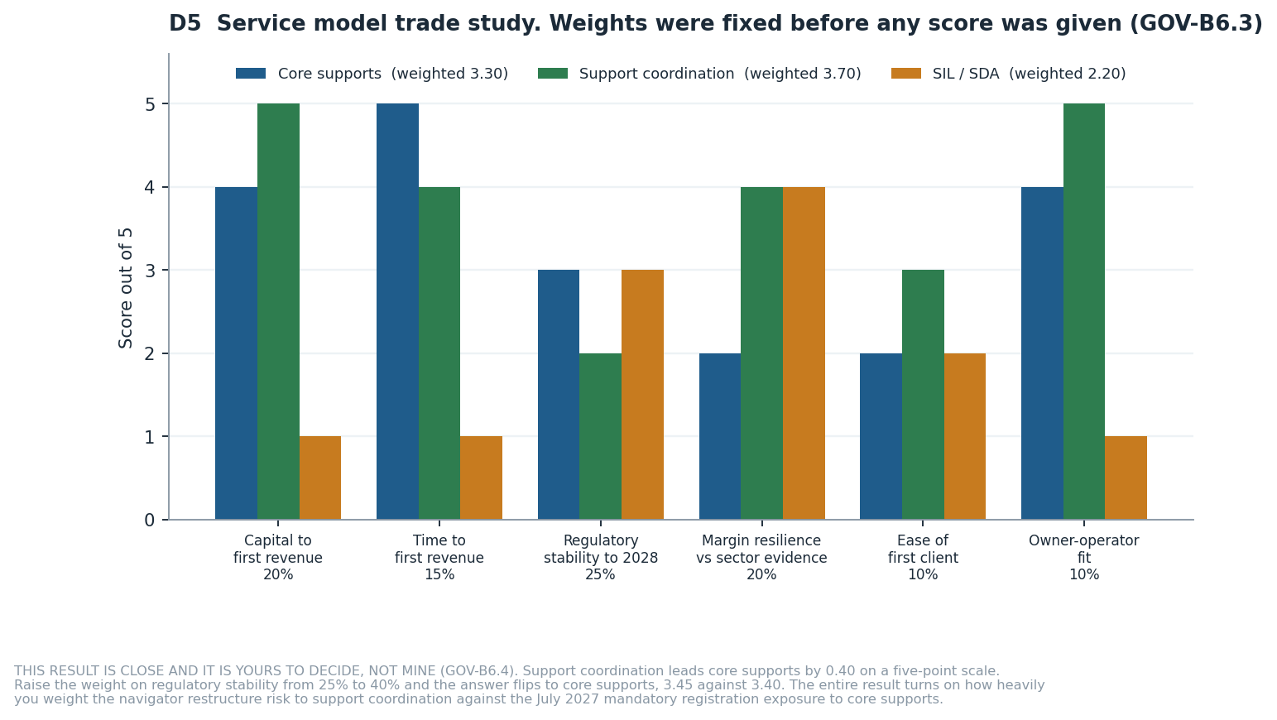
THE TRADE STUDY
Which service model — and why I will not decide it
Support coordination 3.70
Core supports 3.30
SIL / SDA 2.20
That gap is 0.40 on a five-point scale. Raise the weight on regulatory stability from 25% to 40% and it FLIPS: core supports 3.45, support coordination 3.40.
GOV-B6.4 requires me to escalate a decision this close rather than take it.
The judgement is yours: how heavily do you weight the risk that government redesigns support coordination into a "navigator" model, against the certainty that mandatory registration reaches core supports in July 2027? Both are real, both are documented, neither has a settled end state.
07
DEC-003. Weights fixed 20 Aug 2026 BEFORE any alternative was scored, per GOV-B6.3. Sources: SRC-005, SRC-018, SRC-046, SRC-049, SRC-050.

Slide 8
WHAT I RECOMMEND
Proceed — conditionally, cheaply, and in this order
1
Spend two weeks and no capital
Close ACT-005 to ACT-008: four phone calls and two quote requests. They collapse the widest bands in the whole study.
2
Find one operating provider
Ask them their administration hours per billable hour. It is the model's most dangerous assumption and no source publishes a benchmark.
3
Choose on the weight, not the score
Slide 7 gives you the exact criterion weight that flips the answer. Set it yourself.
4
Lodge the registration in month one
Verification takes 4 to 6 months. July 2027 is about eleven months away. Early registration also turns the threat into an advantage.
5
Ring-fence working capital separately
$7,319 to $15,683 that never gets spent on setup.
6
Do not start with SIL or SDA
Registration already mandatory, 9 to 12 month certification, property and 24/7 rostering, 53.7% national utilisation. Revisit in two years.
08
This is a recommendation to DECIDE, not a recommendation to transfer money.

Slide 9
HOW TO DISAGREE WITH ME
What would change this answer
GOV-A1.12 requires that every decision put to you comes with what you would need to check in order to overrule me. These five are that list, ranked by how much they move the answer.
Administration hours
At 0.40 rather than 0.25, core supports loses money on every hour and the recommendation collapses to support coordination or nothing. At 0.10 it becomes materially better than I scored it.
ASM-008 · Low
The SCHADS classification
fairwork.gov.au blocks automated reading. If your workers sit at Level 3, gross margin falls from $21.30 to $15.15 and every break-even rises about 40%.
ASM-002 · Medium
The NDIS price limits
Five limits were read from a 65-page PDF through a summarising fetch. If one is wrong, every revenue figure moves. Two hours of work fixes it (BKL-001).
SRC-002 · Medium
Time to first client
No published benchmark exists. I assumed month four. The slow case assumes month seven and never reaches cash-positive.
ASM-015 · Low
The navigator design
If government preserves support coordination as a fundable service it wins outright. If it absorbs it into a public function the recommendation inverts.
SRC-049
09

Slide 10
WHAT I NEED FROM YOU
Four answers, and this study gives you a number instead of a range
ACT-001
Will you run this yourself full time, or fund it and employ a manager?
Owner-operator break-even is about 40 billable hours a month. An employed manager pushes it past 127.
ACT-002
What must you draw from the business each month, and from when?
Every scenario in this study currently assumes you work for nothing. The runway figure is meaningless until you answer.
ACT-003
What is the maximum you are willing to lose entirely?
I can tell you what it costs. I cannot tell you whether it is affordable for you.
ACT-004
Do you or a co-founder hold relevant qualifications or sector experience?
Support coordination's score depends on you being able to bill personally and be credible to referrers.
Full study: 05_Outputs\NDIS_Business_Enabling_Study_v1.0.docx · Live model: 05_Outputs\NDIS_Financial_Model_v1.0.xlsx · Start here: README.md

