Slide 1
DECISION PACK
NDIS or aged care —
which business, in what order?
The short answer: aged care first. One aged care client contributes $1,002 a month against $435 for one NDIS participant — 2.3 times, on a third of the service hours. Combined capital before first revenue: $44,483 to $52,848.
Prepared for Zaid Al Dabbag · 7 September 2026 · v2.0.0 · AI Project Governance Standard v3.9 with the v4.0 Business Layer, class STANDARD
NDIS facts verified 20 August 2026, aged care facts 7 September 2026. Decision support, not legal or financial advice.
Notes:
This pack summarises the full study at 05_Outputs/NDIS_and_Aged_Care_Business_Enabling_Study_v2.0.docx. Every figure here traces to a SRC-### row in the source register.

Slide 2
WHERE IT LANDS
The eight numbers that decide this
$1,002
$435
-$2.07
$44,483
Contribution per AGED CARE client per month, after paid administration
Contribution per NDIS participant per month, on the same basis
NDIS contribution per hour if administration runs at 0.40 hours per billable hour
Combined capital before first revenue, both entities, drawing NOTHING
5.04 hrs
$11,492+
1 client
127 hrs
What an average aged care budget buys a week — the real constraint, not the price
Working capital behind the wage cycle — a line your earlier plan had no row for
Aged care break-even, administration paid
NDIS break-even a month, administration paid
Read tiles 1, 2 and 3 together. Aged care wins on the unit that matters, and the NDIS number is fragile: there is a plausible, unfalsified version of the NDIS business where every hour you sell loses money.
02
Sources: SRC-060 IHACPA advisory price · SRC-062 SCHADS Schedule F · SRC-063 care-management pool · SRC-064 classification budgets · SRC-002 NDIS price limit · SRC-009 SACS wage · ASM-008 administration ratio and ASM-020 average budget, both Low confidence
Notes:
Tile 3 is the finding. No source publishes an administration-hours benchmark, so 0.40 cannot be ruled out.

Slide 3
YOUR EARLIER FILES
One of eight figures survived contact with a source
What the earlier files said | What the sourced position is
Budget of $15,000 to $30,000 | $15,875 with zero drawings, or $51,875 drawing $6,000/mo — plus working capital on top
Audit $900 to $1,800 | No auditor publishes a fee at all. Consultancy estimate: $3,500 to $6,000 verification
Registration takes 3 to 9 months | Verification 4 to 6 months. Certification 9 to 12 months
Set up a PRODA account | PRODA closes for Commission portals 30 Sep 2026. It is myID Strong plus RAM now
Nothing on mandatory registration | In force for SIL since 1 Jul 2026. Reaches personal care from Jul 2027
Nothing on working capital | $7,319 at a 14-day lag; $15,683 at 30 days
Nothing on the administration burden | It is the entire difference between a viable and an unviable business
ASIC Pty Ltd $636 | Still $636 — the only figure that held
03
DEF-001, raised under GOV-F8.8. The originals are archived, not deleted — 04_Inputs/legacy_unsourced and 06_Archive/_versions.

Slide 4
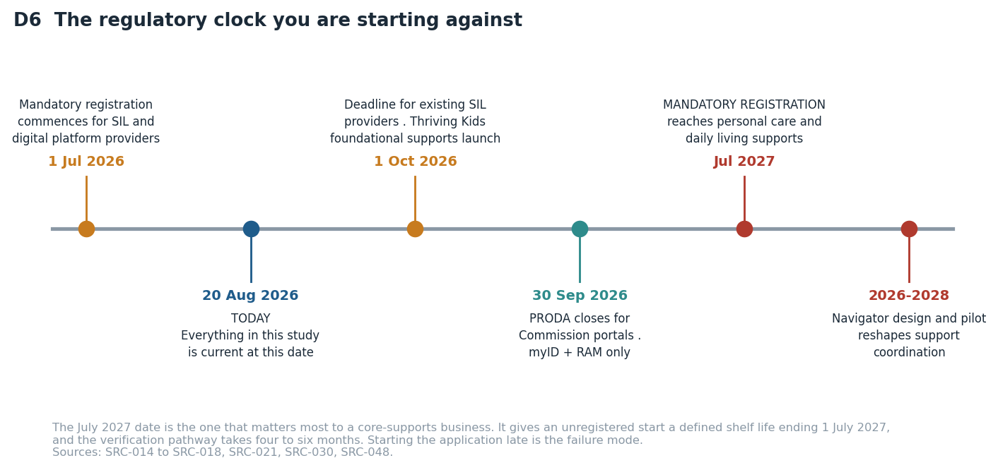
THE REGULATORY POSITION
You are starting against a clock
04
Verified against primary government sources by an independent verifier. Sources: SRC-014 to SRC-018, SRC-030, SRC-048.
Notes:
The July 2027 date is the one that matters. Verification registration takes 4-6 months, so the application starts in month one.

Slide 5
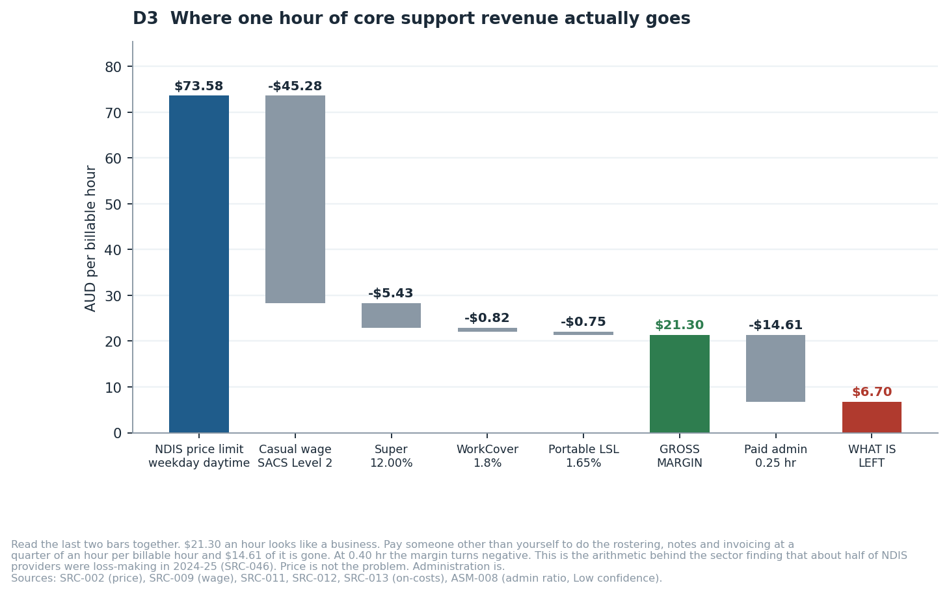
UNIT ECONOMICS
Where one hour of revenue actually goes
05
Independently re-derived by verifier V2, which found the first pass had omitted WorkCover and portable long service leave (DEF-002).

Slide 6
THE CASH CURVE
Twelve months of cash, before you pay yourself anything
Only one line works.
And only if you win a client by month four AND absorb every hour of administration yourself for nothing.
Delay the first client to month seven: never cash-positive in year one ($-4,341).
Pay for the administration: never cash-positive either ($-7,632).
None of these three pays you a wage.
06
REQ-SYS-07. All scenarios assume zero owner drawings. Change one driver in the financial model and every line moves.

Slide 7
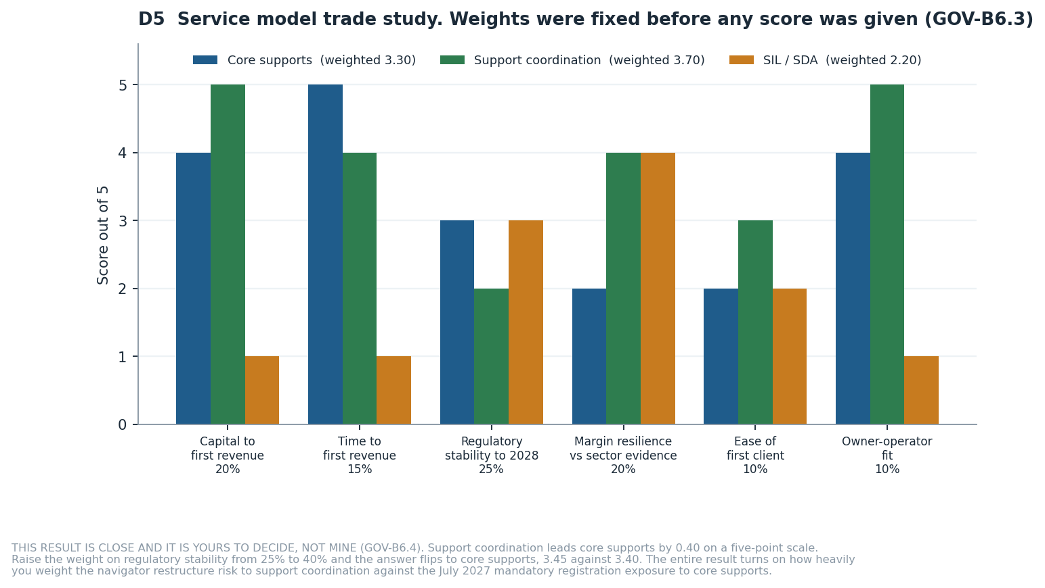
TRADE STUDY 2
Which service model within the NDIS
Support coordination 3.70
Core supports 3.30
SIL / SDA 2.20
That gap is 0.40 on a five-point scale. Raise the weight on regulatory stability from 25% to 40% and it FLIPS: core supports 3.45, support coordination 3.40.
GOV-B6.4 requires me to escalate a decision this close rather than take it.
The judgement is yours: how heavily do you weight the risk that government redesigns support coordination into a "navigator" model, against the certainty that mandatory registration reaches core supports in July 2027? Both are real, both are documented, neither has a settled end state.
07
DEC-003. Weights fixed 20 Aug 2026 BEFORE any alternative was scored, per GOV-B6.3. Sources: SRC-005, SRC-018, SRC-046, SRC-049, SRC-050.

Slide 8
TRADE STUDY 3
Which business to start first — and why I will not decide it
Four options, five criteria, weights fixed and timestamped BEFORE any option was scored.
A
Aged care entity first; NDIS entity registers in parallel and takes clients second
3.70
The margin is 0.15.
Four of the five criteria change the winner within a weight movement you could reasonably make:
• Capital at risk before first revenue: 0.25 → 0.31 hands it to C
• Time to first revenue: 0.20 → 0.28 hands it to C
• Regulatory stability over three years: 0.15 → 0.23 hands it to D
• Independence from the owner's own hours: 0.15 → 0.26 hands it to D
C
Support coordination only; no support workforce, no aged care
3.55
D
Do not start; remain employed
3.20
B
NDIS entity first (core supports); aged care second
2.45
The fork that matters: raise capital preservation from 0.25 to 0.31 and SUPPORT COORDINATION wins instead. If the most you are willing to lose entirely is a small number, option C is the right answer and mine is the wrong one. That is ACT-003, still unanswered. GOV-B6.4 requires me to escalate a result this close, not take it.
08
DEC-007, parked with Zaid. 02_Work/scratch/T3_trade_study_weights.md (weights timestamped 2026-09-07T06:22:16Z, before any option was scored)

Slide 9
THE STRUCTURAL POINT
In aged care the price is not what limits you
In the NDIS the price is a hard ceiling and the volume is open. In aged care the price is not capped but the pot is: each participant holds a FIXED annual classification budget, and when it is spent it is spent.
Classification budget | Service hours a week | Revenue a month | Contribution a month
$10,731 a year | 1.80 hr | $894 | $302
$20,000 a year | 3.36 hr | $1,667 | $639
$30,000 a year | 5.04 hr | $2,500 | $1,002
$45,000 a year | 7.55 hr | $3,750 | $1,547
$60,000 a year | 10.07 hr | $5,000 | $2,092
$78,106 a year | 13.11 hr | $6,509 | $2,749
Even the TOP classification
13.11 hrs a week
Most buy under five. You cannot sell more hours to a willing client — you can only acquire more clients.
That makes this an ACQUISITION business, not a rostering one.
And the paradox: the in-home aged care sector just posted its first negative quarter. Independent verification found the losses sit in legacy overhead and in the replacement of the old dual-fee structure by a single 10% pool — the direct-services line is still positive at about $16.10 per client per day. A new entrant carries neither problem. This is the largest single exposure in the study.
09
SRC-060 advisory price · SRC-063 care-management pool · SRC-064 classification budgets · SRC-068 sector results · ASM-020 average budget (Low confidence) · verified in V4

Slide 10
WHAT I RECOMMEND
Proceed — conditionally, cheaply, and in this order
1
Start the aged care entity first
It breaks even at 1 client, its payment lag is about seven days, and its 10% care-management pool pays for your own time directly.
2
Register the NDIS entity in parallel
Verification takes 4 to 6 months and July 2027 is legislated. Register early, take core-support clients second.
3
Record your first five assessed budgets
The whole aged care case rests on a $30,000 average that is a Low-confidence assumption. At $20,000 the contribution per client falls by a third.
4
Choose on the weight, not the score
Slide 7 gives you the exact criterion weight that flips the answer between aged care and support coordination. Only you can set it.
5
Ring-fence working capital separately
$11,492 to $19,856 across both entities that never gets spent on setup.
6
Name a second operator
Two entities separate legal liability, not operational dependency. Both plans stop on the day you do.
10
This is a recommendation to DECIDE, not a recommendation to transfer money.

Slide 11
HOW TO DISAGREE WITH ME
What would change this answer
GOV-A1.12 requires that every decision put to you comes with what you would need to check in order to overrule me. These five are that list, ranked by how much they move the answer.
Administration hours
At 0.40 rather than 0.25, core supports loses money on every hour and the recommendation collapses to support coordination or nothing. At 0.10 it becomes materially better than I scored it.
ASM-008 · Low
The SCHADS classification
fairwork.gov.au blocks automated reading. If your workers sit at Level 3, gross margin falls from $21.30 to $15.15 and every break-even rises about 40%.
ASM-002 · Medium
The NDIS price limits
Five limits were read from a 65-page PDF through a summarising fetch. If one is wrong, every revenue figure moves. Two hours of work fixes it (BKL-001).
SRC-002 · Medium
Time to first client
No published benchmark exists. I assumed month four. The slow case assumes month seven and never reaches cash-positive.
ASM-015 · Low
The navigator design
If government preserves support coordination as a fundable service it wins outright. If it absorbs it into a public function the recommendation inverts.
SRC-049
11

Slide 12
WHAT I NEED FROM YOU
Four answers, and this study gives you a number instead of a range
ACT-001
Will you run this yourself full time, or fund it and employ a manager?
Owner-operator break-even is about 40 billable hours a month. An employed manager pushes it past 127.
ACT-002
What must you draw from the business each month, and from when?
Every scenario in this study currently assumes you work for nothing. The runway figure is meaningless until you answer.
ACT-003
What is the maximum you are willing to lose entirely?
I can tell you what it costs. I cannot tell you whether it is affordable for you.
ACT-004
Do you or a co-founder hold relevant qualifications or sector experience?
Support coordination's score depends on you being able to bill personally and be credible to referrers.
Full study: 05_Outputs/NDIS_and_Aged_Care_Business_Enabling_Study_v2.0.docx · Live model: 05_Outputs/NDIS_and_Aged_Care_Financial_Model_v2.0.xlsx · Start here: README.md

